Slide 1
GENDER & CSR
Public – Private Partnership
& Corporate Social Responsibility
on Violence Against Women
DIPTO – A Foundation for Gender & Development
Zakia K. Hassan/Mahmuda Imam
7 th September 2014

Slide 2
Background
The relationship between business and women’s power, position within the family and
society is a long standing one. Some argues that women’s integration into the women
development process is a key to their development while others offer more skeptical,
often pessimistic, accounts of these relations.
These contradictory viewpoints reflect a variety of factors, variation in how empowerment
itself is understood, variation in cultural meaning and social acceptability of paid work of
women across different contexts. The nature of available work opportunities within this
particular context differs very often.

Slide 3
Background (Cont.)
The perception of partnership of paid work on various indicators of women empowerment from shifts in decision making processes
to women’s participation in Public Private Partnership (PPP) in a broad perspective.
It finds that forms of work at different organizations offer regular and relatively independent range of income holding out the greater transformative potential. In addition, it highlights a range of other factors that also appear to contribute to women’s power to create spaces in the agency context.

Slide 4
OBJECTIVES of GENDER & CSR
Examine the existing practices, facilities and strategies on PPP and CSR
interventions on VAW issues
To assess the Knowledge, Attitude, Behavior and Practice (KABP) of the
relevant stakeholders

Slide 5
ROLE OF STAKE HOLDERS
The relevant stakeholders were identified based on purposive needs
Main two categories of stakeholders are generally considered:
1. Service Providers
Government, Banks, Corporate, Media, NGOs/Civil Society and Development Partners
2. Service Recipients
Youths, Victims of Violence and Potential Victims

Slide 6
Continued with reference to the Base Line Survey in 2012
A total of 192 respondents were covered through 90 KIIs and 20 FGDs
Additional 7 KIIs and 2 FGDs were conducted
The report was based on both Qualitative and Quantitative Analysis
Operational Definitions on the basis of the objective and themes of the
study were identified

Slide 7
THEMATIC AREAS
On the basis of the operational definitions of the study, the following thematic
areas were analyzed and cases were selected:
Types and extent of violence against women at workplace
Profile, roles, responsibilities & participation of different stakeholders
Approach towards PPP & CSR on VAW
Coordination, Coherence, Cooperation & Networking
Institutional management of service providers, sustainability & continuity of CSR ventures
Expectations & suggestion for promoting CSR activities

Slide 8
Types of Violence
at Workplace

Slide 9
Existing Gender Facilities
related to VAW in the workplace
Category |  | Gender facilities related to VAW |  |  | Total
 |  | Yes | No | No Answer
Service Providers (SP) | Government | 31 | 8 | 2 | 41
 | Bank
 | Corporate
 | NGO & Civil Society
 | Media
 | Development Partners
% of Total |  | 34.4% | 8.9% | 2.2% | 45.6%
Service Recipients (SR) | Potential Victim | 15 | 22 | 12 | 49
 | Victim of VAW
% of Total |  | 16.7% | 24.4% | 13.3% | 54.4%
Total |  | 46 | 30 | 14 | 90
% of Total |  | 51.1% | 33.3% | 15.6% | 100.0%

Slide 10
Incidences of Violence
at Workplace
Table: 2: Incidences of major types of violence cases identified at workplace
Category |  |  | Violence at workplace happened |  |  | Total
 |  |  | Yes | No | No Answer
Service Providers (SP) | Government |  | 7 | 33 | 1 | 41
 | Bank
 | Corporate
 | NGO & Civil Society
 | Media
 | Development Partners
% of Total |  |  | 7.8% | 36.7% | 1.1% | 45.6%
Service Recipients (SR) |  | Potential Victim | 21 | 28 | 0 | 49
 |  | Victim of VAW
% of Total |  |  | 23.3% | 31.1% | .0% | 54.4%
Total |  |  | 28 | 61 | 1 | 90
% of Total |  |  | 31.1% | 67.8% | 1.1% | 100.0%

Slide 11
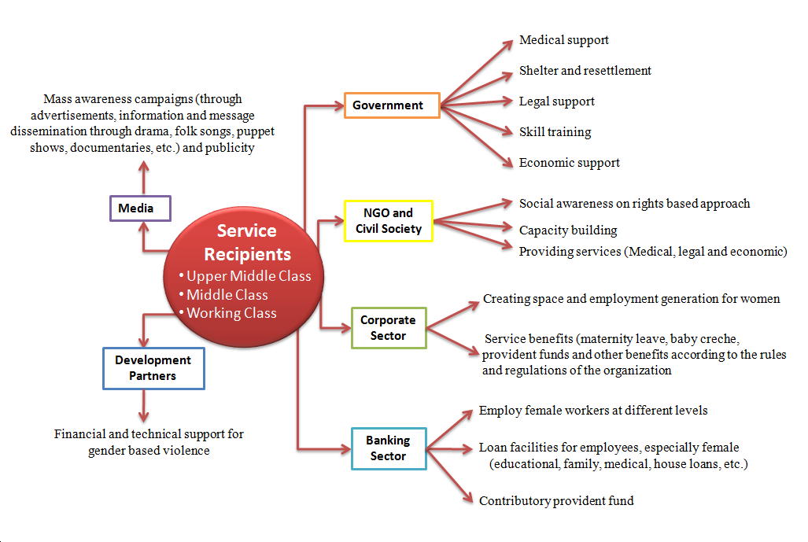
Sociometry of networking amongst the stakeholders

Slide 12
KEY FINDINGS
Conceptual clarity of CSR is one of the crucial aspects for understanding of the stakeholders at all levels and its applications
Awareness raising and mobilization for PPP and CSR on VAW issues are essential
Current KABP level does not capacitate the service providers to manage violence issues at the workplace.
Existing Government’s PPP funds have not been used or applied for social sector (especially, the issues of VAW).
The stakeholders, especially the service providers (government, NGOs and civil society, banks, corporate, media and developing partners) are optimistic about broader collaboration for the benefits of the service recipients.

Slide 13
KEY FINDINGS (Continued)
Alliance building is possible currently only with the civil society organizations as they practice.
The existing gender ratio among the service providers at the top-level management has been found imbalanced.
The policies at the workplaces were not strong enough to handle the gender discrimination approaches within the organizations.
It is found that corporate, multinationals and banking sector are having CSR policies.
It has been found that there is a crucial need to strengthen the monitoring mechanism for the service providers including NGOs and other relevant agencies involved in the process.

Slide 14
KEY FINDINGS (Continued)
Media personalities (electronic and print) are not well aware of the applications of CSR, especially on VAW issues.
It has been found that many NGOs and CBOs are interested to come forward with ideas and new approaches seeking support from the corporations proactively.
Female workers are often overloaded with work and also harassed by their male colleagues at the workplace frequently.
Proper networking is required to establish the linkages among the service providers.
Recent intervention in the academic field will be beneficial to the process.
Approach of CSR is being taken as philanthropic approach rather than a social obligation, which is crucial responsibility for the stakeholders.

Slide 15
RECOMMENDATIONS
Short Term
Service providers immediately should take necessary measures to promote corporate social responsibility issues on VAW which includes the conceptual clarity of the stakeholders. It should also include the capacity building aspect.
Government policies about PPP should be immediately taken into action so that initiatives on social sector issues focusing on gender based violence at the workplace. It should enhance the responsibility and accountability for CSR initiatives effectively.
The quality of the services provided by the NGOs should be enhanced and reinforced for greater collaboration and networking with government agencies for providing support to the CSR initiatives on VAW. They should take initiative to link and refer the cases through coordination of available services provided by government and other agencies.

Slide 16
RECOMMENDATIONS (Continued)
4. With regard to banking sector significant knowledge and capacity on violence issues with regard to CSR project should be enhanced. Promotion of social issues focusing on gender should be included as practical actions of day to day business of the banks. BB policy implementation should be crucial.
5. Corporate sector should be more aware of gender inclusion on rights
based approach and also implement the existing policies by creating
spaces for women employees at the mid and top level management.
6. Media should play a vital role to incorporate gender based violence in
their reporting system. This should be a mandate for media
personalities to have the responsibility and accountability for social
awareness campaign about the issue.

Slide 17
RECOMMENDATIONS (Continued)
5. It should be congenial that academic courses and its implication
towards the youth group to understand the social problem on violence
issues and to apply CSR initiatives which would encourage them to
take necessary actions in their future endeavors.
6. Gender-friendly working environment should be implemented at the
workplace.

Slide 18
RECOMMENDATIONS (Continued)
Medium Term
Mechanisms should be strengthened and enhanced by all the stakeholders according to their relevancy and should continue for quality interventions.
Pro-gender policies need to be essential for women to work professionally. Working environment with regards to rights based approach should be one of the major agendas of the organizations so that gender based violence is reduced significantly.
Collaboration among the stakeholders should be enhanced to establish and strengthen the VAW related networks.
Transparent and accountable practices with integrity and togetherness should be crucial to achieve positive results.

Slide 19
RECOMMENDATIONS (Continued)
5. Media personalities should have commitments on gender issues and
human rights and they should be made conscious and sensitive about it.
6. There should be many organizations who should allocate investment
for CSR and for greater effect on the issue. There should also be a
common platform for such organizations which should be invested
and accumulated collectively in order to implement larger and more
effective actions.
7. The factory owners should influence the other partners to improve the
working conditions focusing on female workers through CSR and also
should have greater communication among themselves for
information sharing and dialogue.
8. Inclusion of the youth and the future generations should be taken into
consideration seriously to prevent VAW incidences at workplace and to
develop a positive growth of interventions in the future.

Slide 20
RECOMMENDATIONS (Continued)
Long Term
Linkages and conceptual clarity about PPP and CSR practices should be established among the stakeholders especially within the relevant ministries those who deal with gender issues like MOWCA, MOHA, MSS, Education, Health and Law & Justice. Technical know-how of CSR initiatives should be a challenge for future interventions.
Strengthening awareness raising programs to enhance the quality of services by using a collaborative approach between all the stakeholders should be necessary.
The relevant ministries should develop a holistic approach and strategy for the VAW focusing on CSR initiatives for further institutionalization of the processes.

Slide 21
RECOMMENDATIONS (Continued)
4. A Standard Operational Procedure (SOP) with regard to VAW should
be introduced by the government ministries to the regulators of the
RMG sector (BGMEA, BKMEA and other chambers). The garment
owners should follow the procedure strictly.
5. Creating employment opportunities and resettlement options should
be integral part of the plans of the interventions related to VAW issues.
6. PPP and CSR initiatives for enhancing the employment generation
should be possible with commitments and better understanding of the
partners.
7. Linkages should be established among the service providers which is
essential in order to provide integrated services to the female workers
at the workplace.

Slide 22
RECOMMENDATIONS (Continued)
8. With regard to sustainability and continuity of the initiatives, a
comprehensive CSR intervention should be coordinated and
collaborated among the stakeholders through the partnership
approach which should contribute to ethical business and also to
economic growth.
9. The organizations should introduce to contribute a certain percentage
from the yearly profit which should be applied for CSR interventions.
10. The CSR tasks should not be continued as philanthropic or welfare
approach but should be taken as a responsibility for sustainable
development. Recognition should be required from the government
and other stakeholders for the partners who should take pro-active
actions towards the gender based violence issues through CSR.

Slide 23
Thank you

